Slide 1
Matrix approach to CMIP6 and TRENDY
Working group
22 June 2021

Slide 2
Description of a model
Model name
Lead PI or contact person and her/his affiliation.
Static or dynamic vegetation
Number of plant functional types
What disturbances are simulated (e.g., land use or fire etc.)?
Number of pools
How are pools connected? (i.e., carbon flow diagram)
Outputs for CMIP6 or TRENDY

Slide 3
CMIP6 - CLASS-CTEM
Model name: CLASS (Canadian Land Surface Scheme) – CTEM (The Canadian Terrestrial Ecosystem Model)
Lead PI or contact person and her/his affiliation: Vivek Arora, vivek.arora@canada.ca (I THINK), recent publication by a post-doc: https://doi.org/10.5194/gmd-2017-169
Static or dynamic vegetation: dynamic vegetation (simulated by CTEM with daily time step, then passed to CLASS)
Number of plant functional types: see next slides
What disturbances are simulated (e.g., land use or fire etc.)?: fire, land use change
Number of pools: 5 pools (3 living vegetation: leaves, stems, roots; 2 dead carbon: soil organic matter and litter)
How are pools connected? (i.e., carbon flow diagram): see next slides
Outputs for CMIP6 or TRENDY: access for CMIP6 via : https://esgf-node.llnl.gov/search/cmip6/

Slide 4
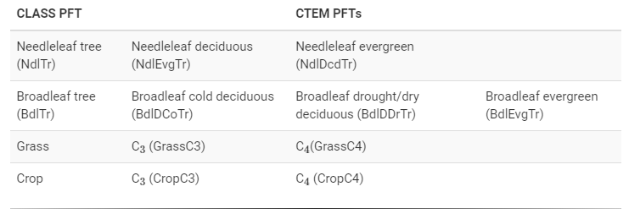
CMIP6 - CLASS-CTEM

Slide 5
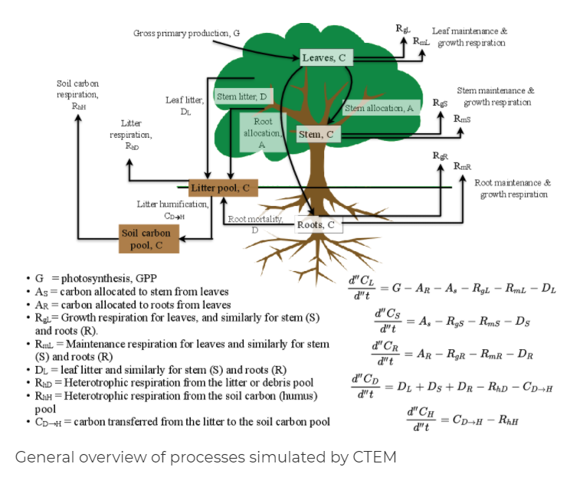
CLASS-CTEM
Growth Resp.
Maintenance Resp.
Gross Primary Production
Respiration
Leaf C
Litter
Stem C
SOM
Root C
Note from Sarah: I’m not sure yet how the plant functional types are used in this carbon flow diagram. Is there a different parameter for each pft?
https://cccma.gitlab.io/classic_pages/info/ctem/#fn:10

Slide 6
TRENDY - CLASSIC
Model name: CLASSIC - The Canadian Land Surface Scheme Including biogeochemical Cycles (CLASSIC)
Lead PI or contact person and her/his affiliation:Vivek Arora, vivek.arora@canada.ca, open-source community successor to CLASS-CTEM (https://cccma.gitlab.io/classic_pages/model/)
Static or dynamic vegetation: dynamic in CTEM
Number of plant functional types: not limited, but currently original from CLASS-CTEM with addition of shrubs and sedges (12 PFTs)
What disturbances are simulated (e.g., land use or fire etc.)?: fire, land use change
Number of pools: 5 pools (leaf, stem, root, litter, soil organic matter)
How are pools connected? (i.e., carbon flow diagram): see next slides
Outputs for CMIP6 or TRENDY: output variables can be found here
(http://dgvm.ceh.ac.uk/files/Trendy_ListofVariables_Nov2011.pdf)
but I’m not clear on a download link similar to CMIP6

Slide 7
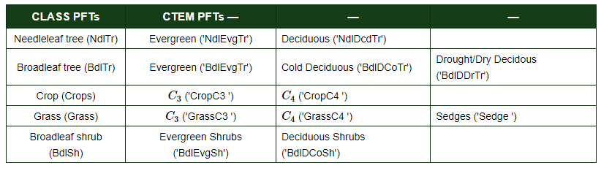
TRENDY - CLASSIC
*CLASSIC IS NOT LIMITED TO THESE PFTs, more can be added.

Slide 8
CLASSIC
Rate change equations: https://cccma.gitlab.io/classic/overviewCTEM.html#CTEMRateChgEqns
* there’s no growth respiration if NPP <0
Growth Resp.
Maintenance Resp.
CO2 associated with Fire
Gross Primary Production
Mortality associated with fire
Respiration
Leaf C
Litter
Stem C
SOM
Root C
Note from Sarah: I’m not sure yet how the plant functional types are used in this carbon flow diagram. Is there a different parameter for each pft?

